Slide 1


My Fitness Program
By:
Duc Nguyen Cameron Rabiyan Dongpyeong Seo
Matthew Stone Tung Lin-Lee Tarun Sivakumar

Slide 2

Our Purpose
Make customizing and viewing fitness programs easier
Simpler platform
Share programs with friends
Share knowledge

Slide 3

Goals
Efficiently search a program
Efficiently create their own program
Upload personal programs and share with others
Export programs to email
Give a feedback for programs

Slide 4
DevelopmentAl MIlestones
Challenges
Accomplishments
No experience in web development
Hard communication at the beginning
Hard to distribute tasks
Played with new languages / frameworks
Learned Scrum
Created a working product with team members

Slide 5
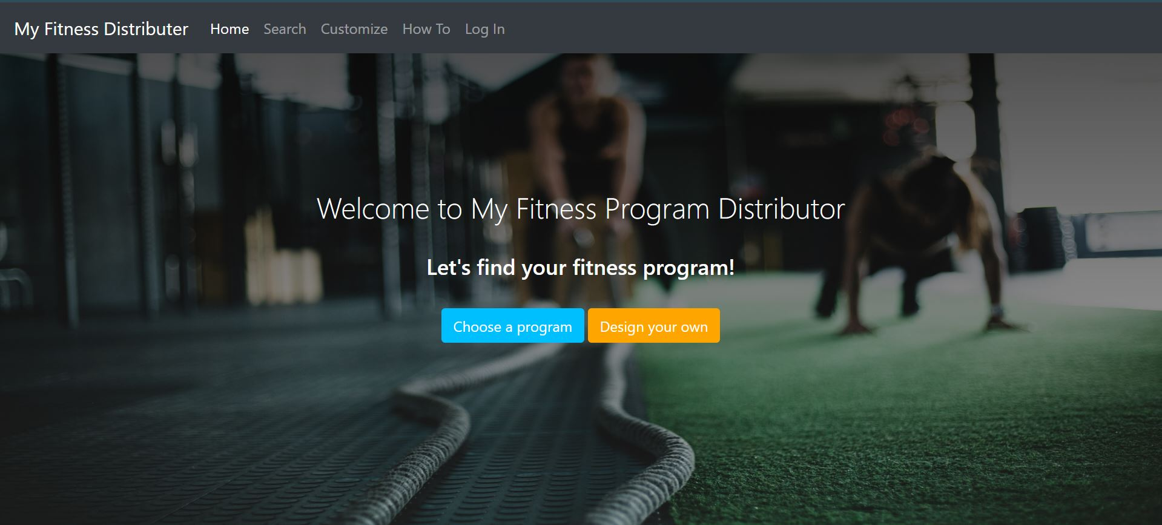
Main Page

Slide 6
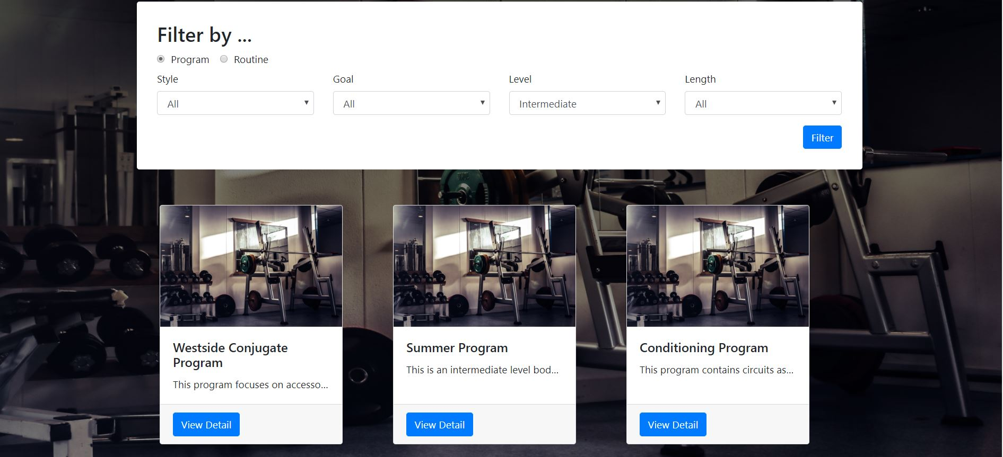
Workout program page

Slide 7
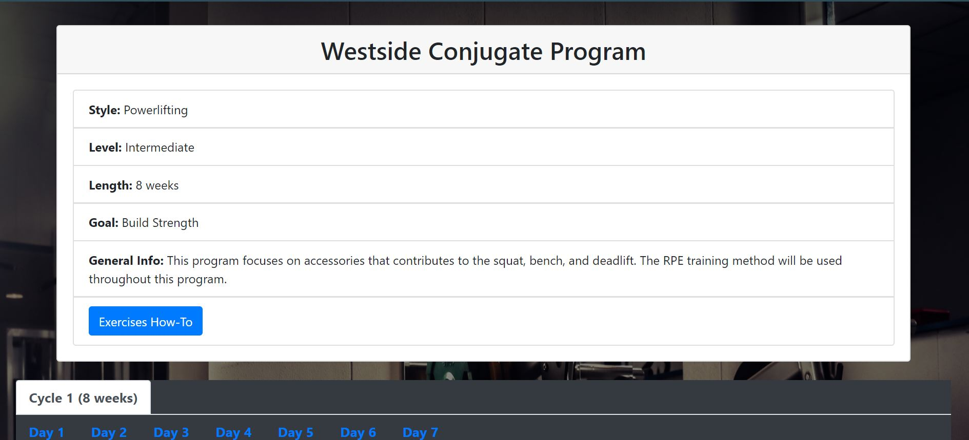
program detail page

Slide 8
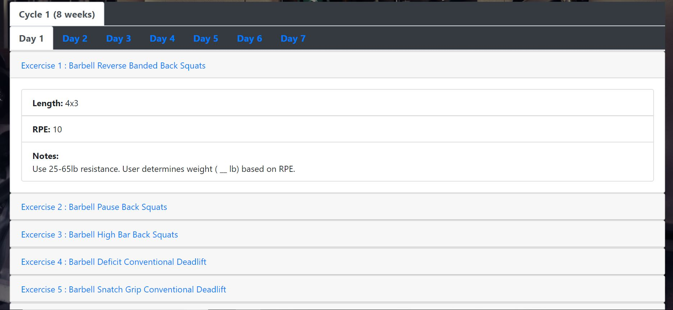
program detail page (continue)

Slide 9
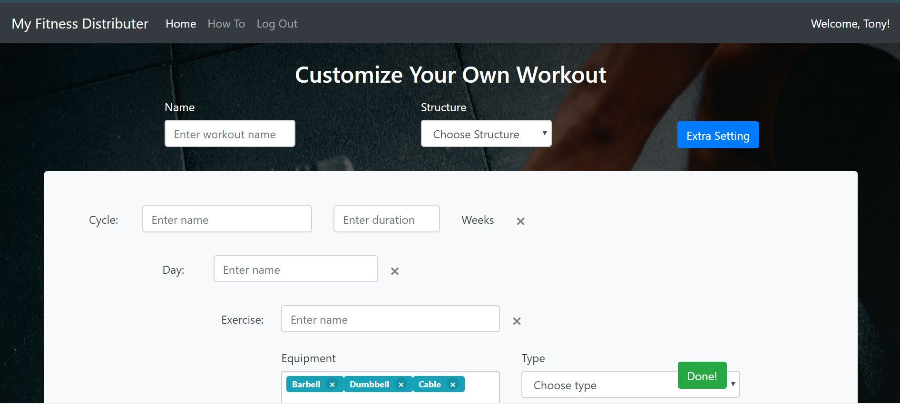
Customize page

Slide 10
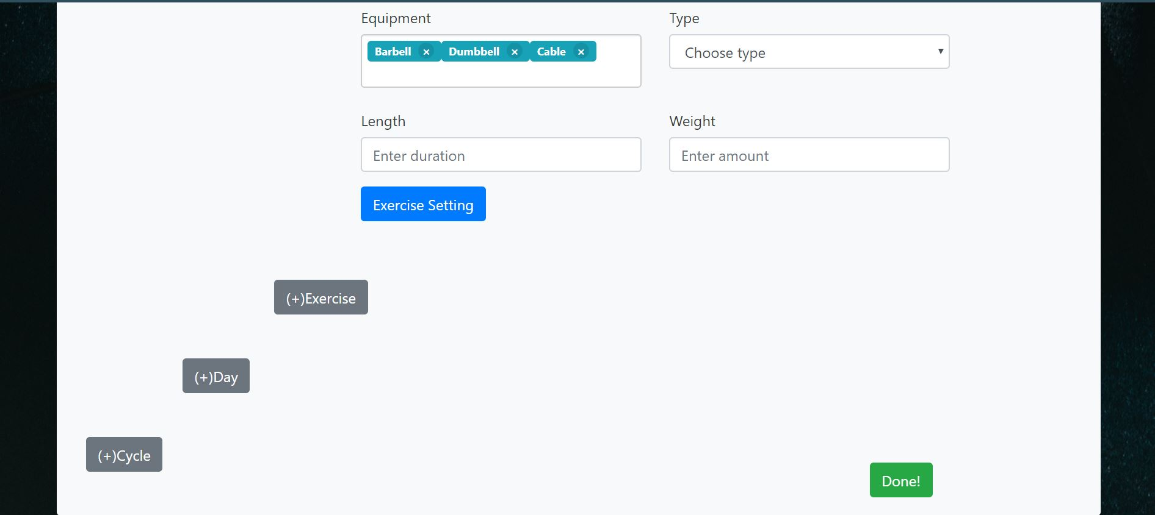
Customize page (continue)

Slide 11
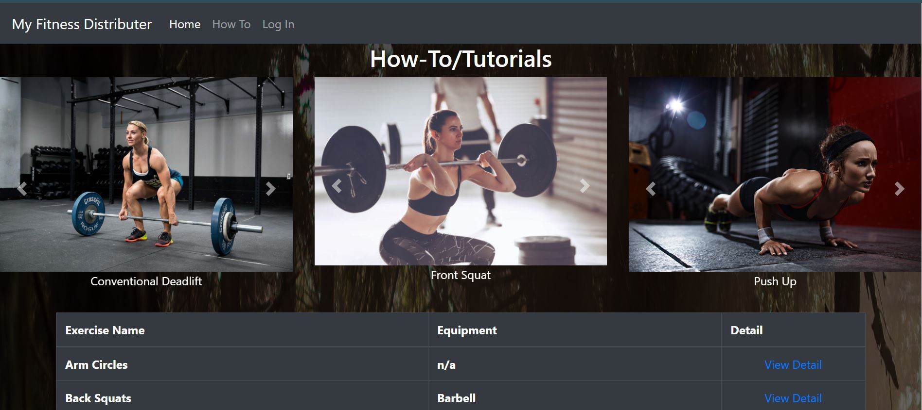
How To page

Slide 12
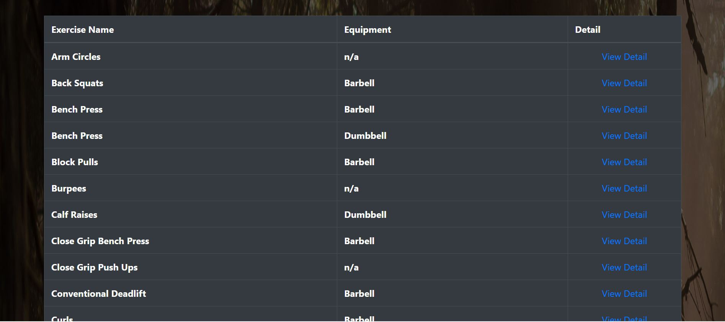
How To page (continue)

Slide 13
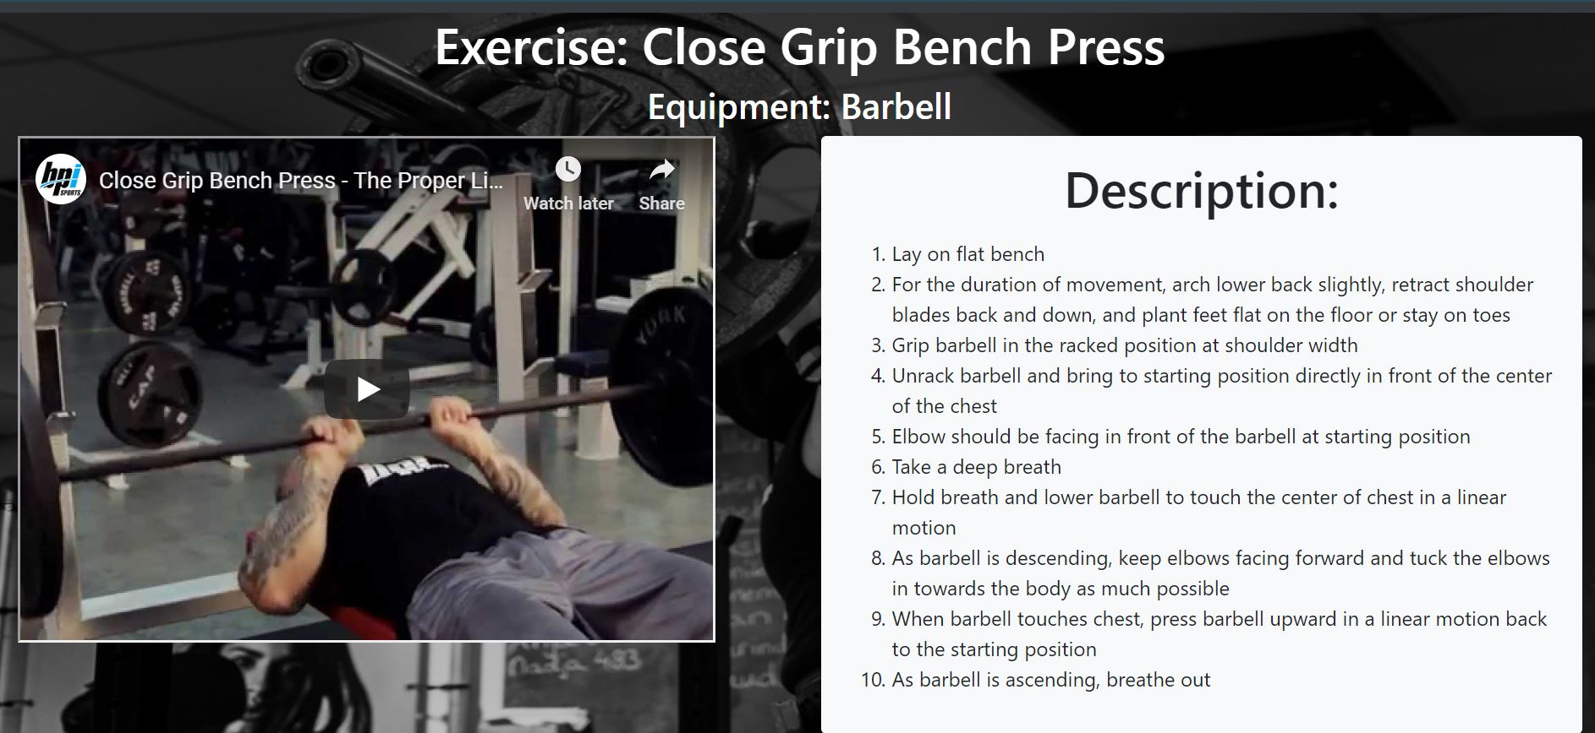
Exercise Detail

Slide 14
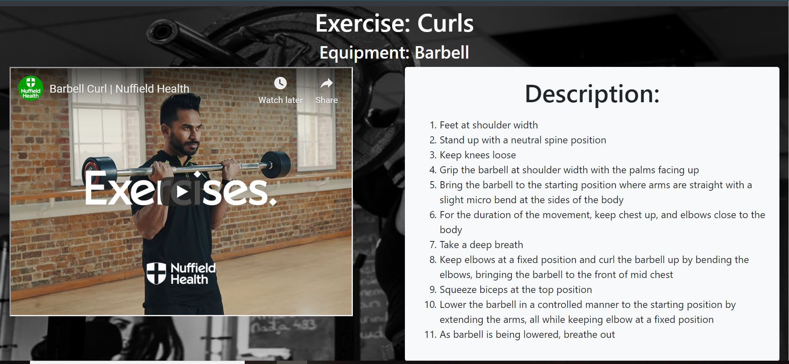
Exercise detail (continue)

Slide 15
System Diagram
Server
DB
‘accounts’
‘workouts’
Parser
Workout Document
Authorization
Filtering logic
Store workouts
Retrieve tutorials
Workouts
Tutorials
UI
Login
Search Workouts
Customize Workouts
Check tutorials

Slide 16
Technologies Used
Server
MongoDB
DB
‘accounts’
‘workouts’
Parser
Workout Document
AWS
Authorization
Filtering logic
Store workouts
Retrieve tutorials
Python-Flask
Workouts
Tutorials
HTML, CSS, JS
with Bootstrap4
UI
Login
Search Workouts
Customize Workouts
Check tutorials

Slide 17

Project Management
Slack for communication
Github for version control
Trello for scrum board
Daily meeting (3 per week) in same place
Strictly followed 15-min, 3-questions meeting!

Slide 18
The Development Experience
What we Didn’t like
What we liked
Finding time in each others’ schedules
Errors from unfamiliar front-end world ☹
Learning new ways to code
New experiences, and new insights from our first web development!

Slide 19

What we learned
Web development skills
Scrum
Communication is SO IMPORTANT!
Sharing progress frequently
Assigning proper tasks
Proper document for co-working

Slide 20
Thank you for listening!

